Slide 1

8.11 Row operations

Slide 2
Introduction
In this topic, we will
  Review the row operations on a matrix
  See that each row operation is a linear operator,
  and thus can be represented by a square matrix
  Find these matrices
  Observe that these matrices are invertible

Slide 3
Row operations
There are three row operations:
  Swapping two rows
  Adding a multiple of one row onto another
  Multiplying a row by a non-zero scalar
Previously, we represented these operations by an italicized capital R with a subscript
R_{Ri ↔ Rj} R_{α Ri → R j} R_{α Ri}
  Recall also that all linear maps are represented by such letters

Slide 4
Swapping two rows
Suppose that A ∈ ℒ (R^{n}, R^{m}),
so A is representable by an m × n matrix
Recall that the matrix-matrix multiplication BA can be found by multiplying each column vector of A by B, so
BA = (Ba₁ ··· Ba_{n})
Question: How can we swaps two entries of each a_{k}
Now, swapping two entries in a vector is a linear mapping,
for it doesn’t matter if we swap those entries in β u₁ + γ u₂
or swap the two entries of u₁ and u₂ and then take the same
linear combination of the results
  The resulting vector will be the same dimension: m
  Thus, the linear operator is an m × m matrix
Question: what is the matrix R_{R i ↔ R j}?

Slide 5


Swapping two rows

Slide 6
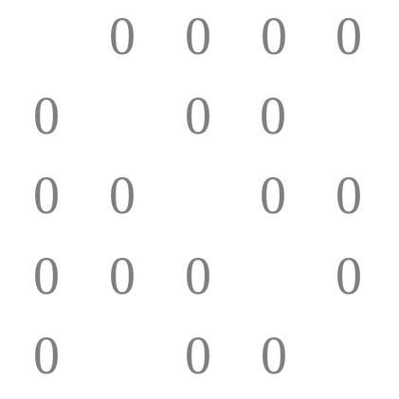
Swapping two rows
Suppose we want to swap Rows 2 and 5 of this matrix
  Multiply on the left by R_{R2↔R5}

Slide 7
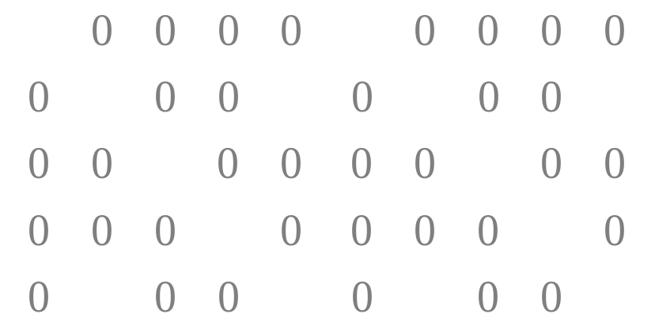
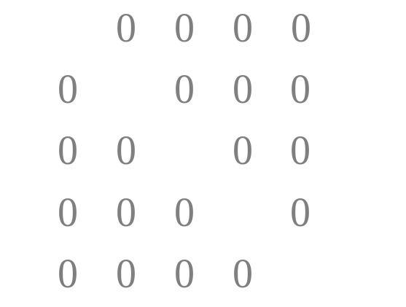
Swapping two rows
Now, we can undo the operation of swapping two rows by once again swapping two rows
  Consequently, this linear operator is its own inverse:

Slide 8
Adding a multiple of one row onto another
Again, A ∈ ℒ (R^{n}, R^{m}) and is represented by an m × n matrix
Again, we have
BA = (Ba₁ ··· Ba_{n})
Question: How can we add a multiple of one row onto another?
Now, adding a multiple of one entry onto another is linear,
for we can do this mapping after calculating β u₁ + γ u₂
or we can do this mapping first on both u₁ and u₂ and
then take the same linear combination of the results
  The resulting vector will be the same dimension: m
  Thus, the linear operator is an m × m matrix
Question: what is the matrix R_{α Ri → R j}?

Slide 9

Adding a multiple of one row onto another

Slide 10
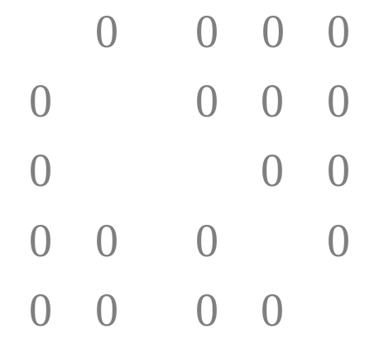
Adding a multiple of one row onto another
Suppose we want to add 0.5 times Rows 2 onto Row 3:
  Multiply on the left by R_{0.5R2→R3}

Slide 11
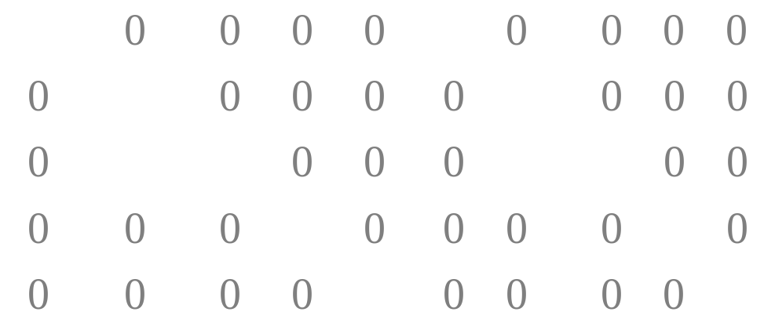
Swapping two rows
Now, we can undo the operation of adding a multiple of one row onto another?
  Yes, subtract that same multiple of the one row from the other:

Slide 12
Multiplying a row by a non-zero scalar
Again, A ∈ ℒ (R^{n}, R^{m}) and is represented by an m × n matrix
Again, we have
BA = (Ba₁ ··· Ba_{n})
Question: How can we multiply a row by a non-zero scalar?
Now, multiplying an entry by a non-zero scalar is linear,
for we can do this mapping after calculating β u₁ + γ u₂
or we can do this mapping first on both u₁ and u₂ and
then take the same linear combination of the results
  The resulting vector will be the same dimension: m
  Thus, the linear operator is an m × m matrix
Question: what is the matrix R_{α Ri} ?

Slide 13

Multiplying a row by a non-zero scalar

Slide 14
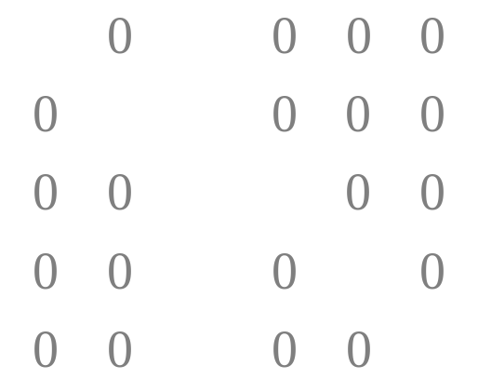
Multiplying a row by a non-zero scalar
Suppose we want to multiply Rows 2 by –0.125:
  Multiply on the left by R_{–0.125R2}

Slide 15
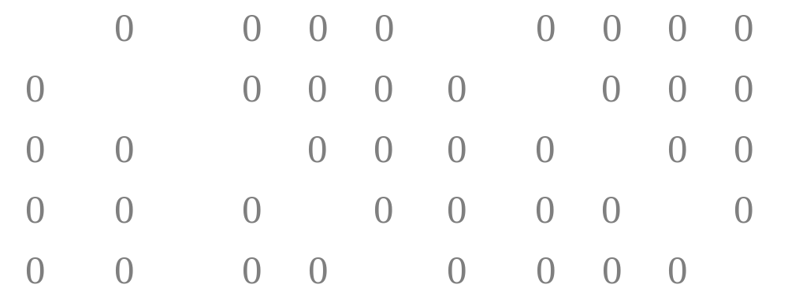
Multiplying a row by a non-zero scalar
Now, we can undo the operation of multiplying a row by a
non-zero scalar?
  Yes, multiply that row by the multiplicative inverse of that scalar:

Slide 16
Summary
Following this topic, you now
  Know that each row operation can be represented by a matrix
  Understand that each of these matrices has inverses

Slide 17
References
[1] https://en.wikipedia.org/wiki/Elementary_matrix

Slide 18
Acknowledgments
None so far.

Slide 19



Colophon
These slides were prepared using the Cambria typeface. Mathematical equations use Times New Roman, and source code is presented using Consolas. Mathematical equations are prepared in MathType by Design Science, Inc.
Examples may be formulated and checked using Maple by Maplesoft, Inc.
The photographs of flowers and a monarch butter appearing on the title slide and accenting the top of each other slide were taken at the Royal Botanical Gardens in October of 2017 by Douglas Wilhelm Harder. Please see
https://www.rbg.ca/
for more information.

Slide 20
Disclaimer
These slides are provided for the ne 112 Linear algebra for nanotechnology engineering course taught at the University of Waterloo. The material in it reflects the authors’ best judgment in light of the information available to them at the time of preparation. Any reliance on these course slides by any party for any other purpose are the responsibility of such parties. The authors accept no responsibility for damages, if any, suffered by any party as a result of decisions made or actions based on these course slides for any other purpose than that for which it was intended.

